Slide 1


2.8 代码生成
表达式代码生成 expr → expr₁ + term
expr对应的汇编码是怎样的？
计算expr₁的代码段
计算term的代码段
MOV EAX, expr₁
MOV EBX, term
ADD EAX, EBX
MOV expr, EAX
转化为语法制导定义：
expr → expr₁ + term {
expr.addr=newtemp;
expr.code =
expr₁.code || term.code ||
“MOV EAX, expr₁.addr MOV EBX, term.addr ADD EAX, EBX MOV expr.addr, EAX” }
语法符号的属性——对应语法结构的汇编代码
上层语法结构的代码——下层语法结构的代码再拼接一些汇编指令而来

Slide 2

表达式的代码生成（续）
stmt → id := expr
赋值语句的汇编码应该是什么样子？
计算expr的代码段
MOV EAX, expr
MOV id, EAX
stmt → id := expr
{stmt.code = expr.code ||
“MOV EAX, expr.addr
MOV id.addr, EAX”}

Slide 3
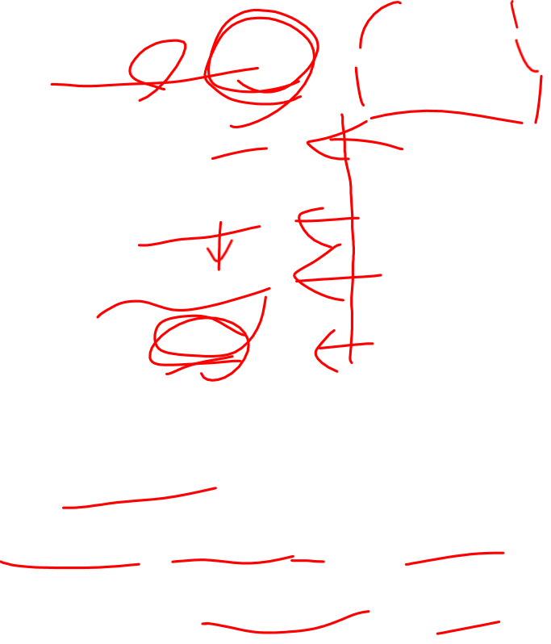
控制流的翻译
IF (expr) stmt
code for expr
jz out
code for stmt
out:
stmt → if (expr) stmt₁
{ out = newlabel; stmt.code = expr.code || ‘jz’ out || stmt₁.code || out }

Slide 4
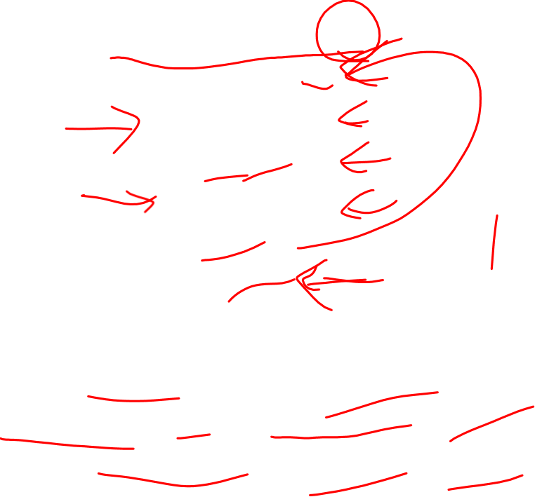
控制流语句的翻译
WHILE (expr) stmt
L1:
code for expr
jz out
code for stmt
jmp L1
out
stmt → while (expr) stmt₁ { test = newlabel; out = newlabel; stmt.code := test || expr.code || ‘jz’ out || stmt₁.code || ‘jmp’ test || out }

Slide 5
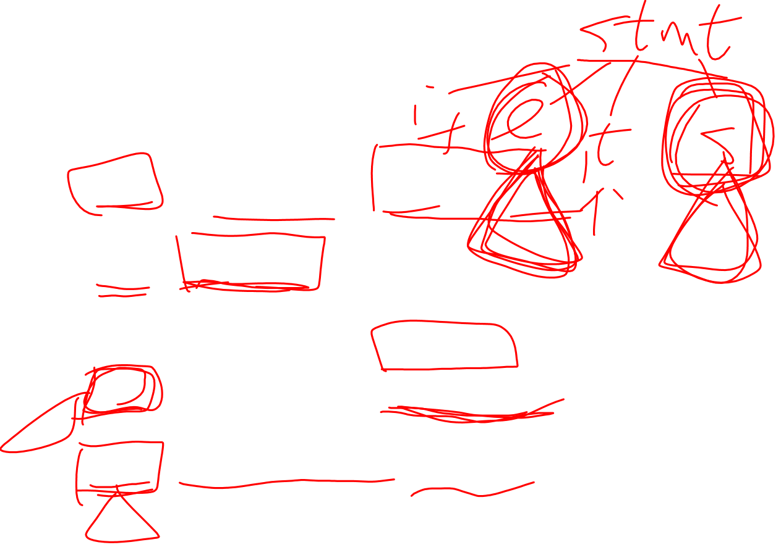
2.8.7 翻译模式
stmt → if expr {out := newlabel; print(‘jz’, out);} then stmt₁ { print(out); }
stmt → while {test := newlabel; print(test);} expr {out := newlabel; print(‘jz’, out);} then stmt₁ { print(‘jmp’, test); print(out);}

Slide 6
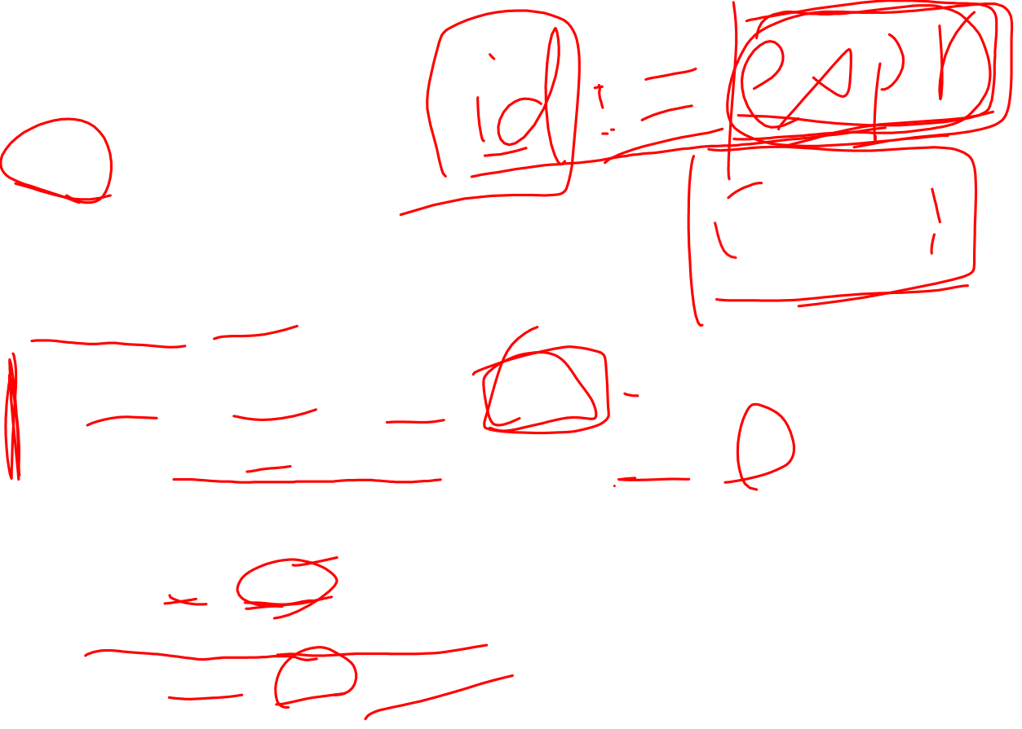
stmt分析函数
void stmt()
{
int test, out;
if (lookahead == id) {
int left = lval, right;
match(id); match(‘:=’); right = expr();
print(“MOV EAX, ”, right,“\n MOV ”, right, “,EAX”);
}
else if (lookahead == ‘if’) {
match(‘if’); expr();
out=newlabel; print(‘jz’, out);
match(‘then’); stmt(); print(out);
}
else error();
}

